Slide 1


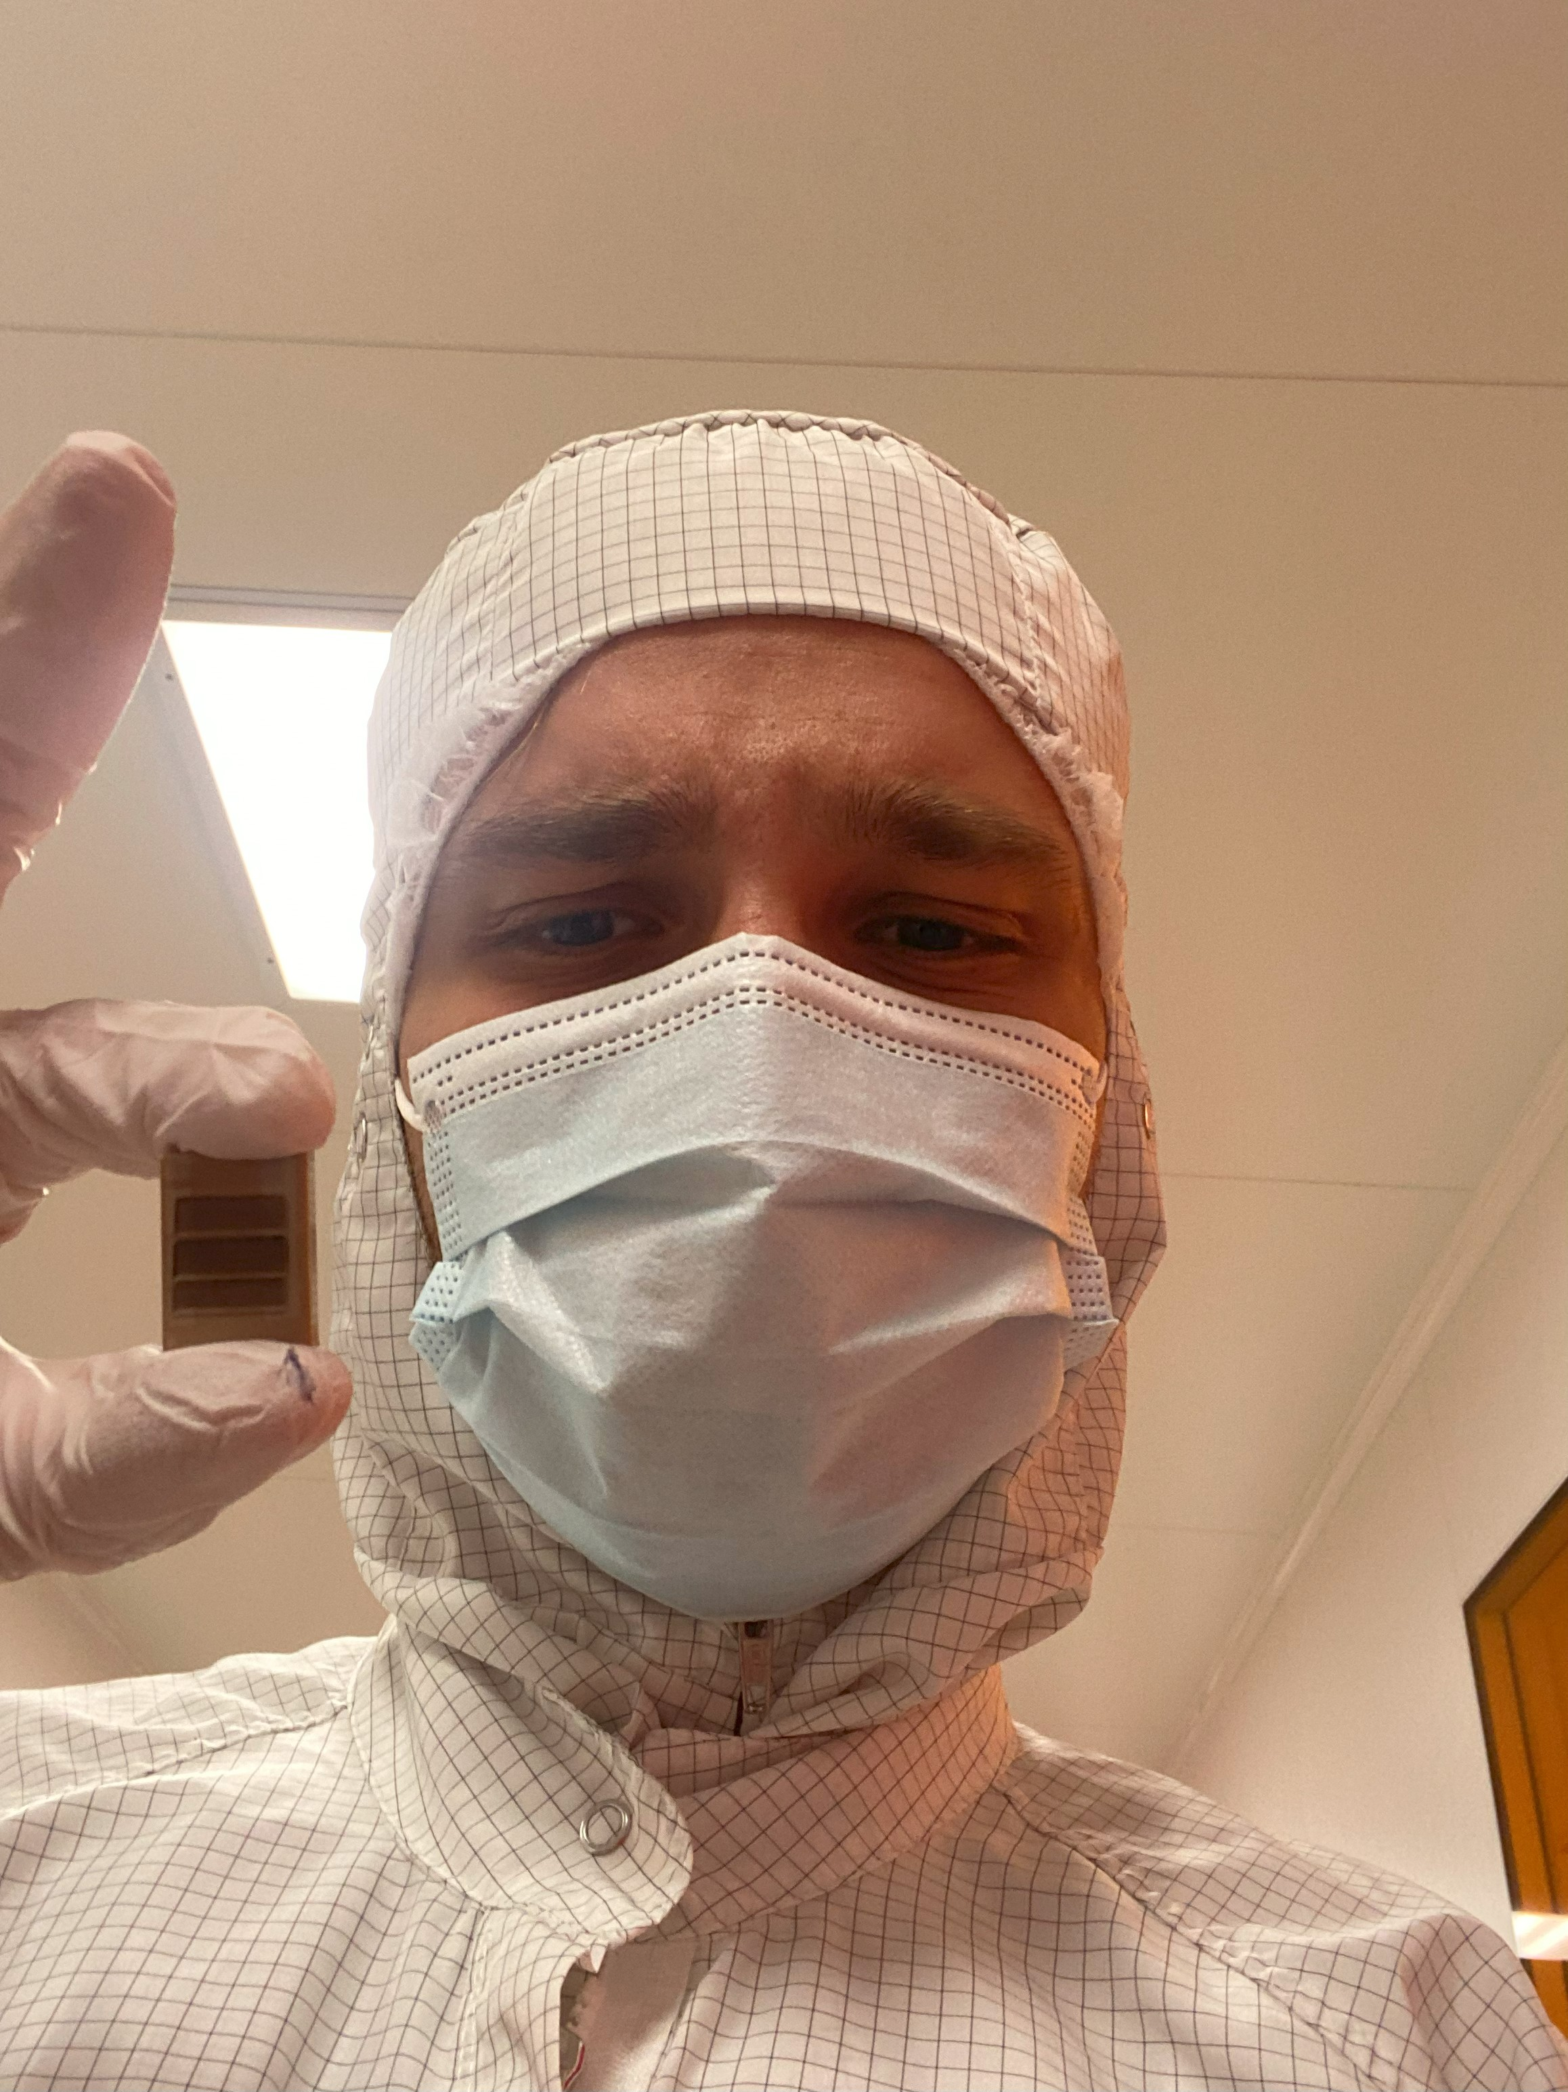
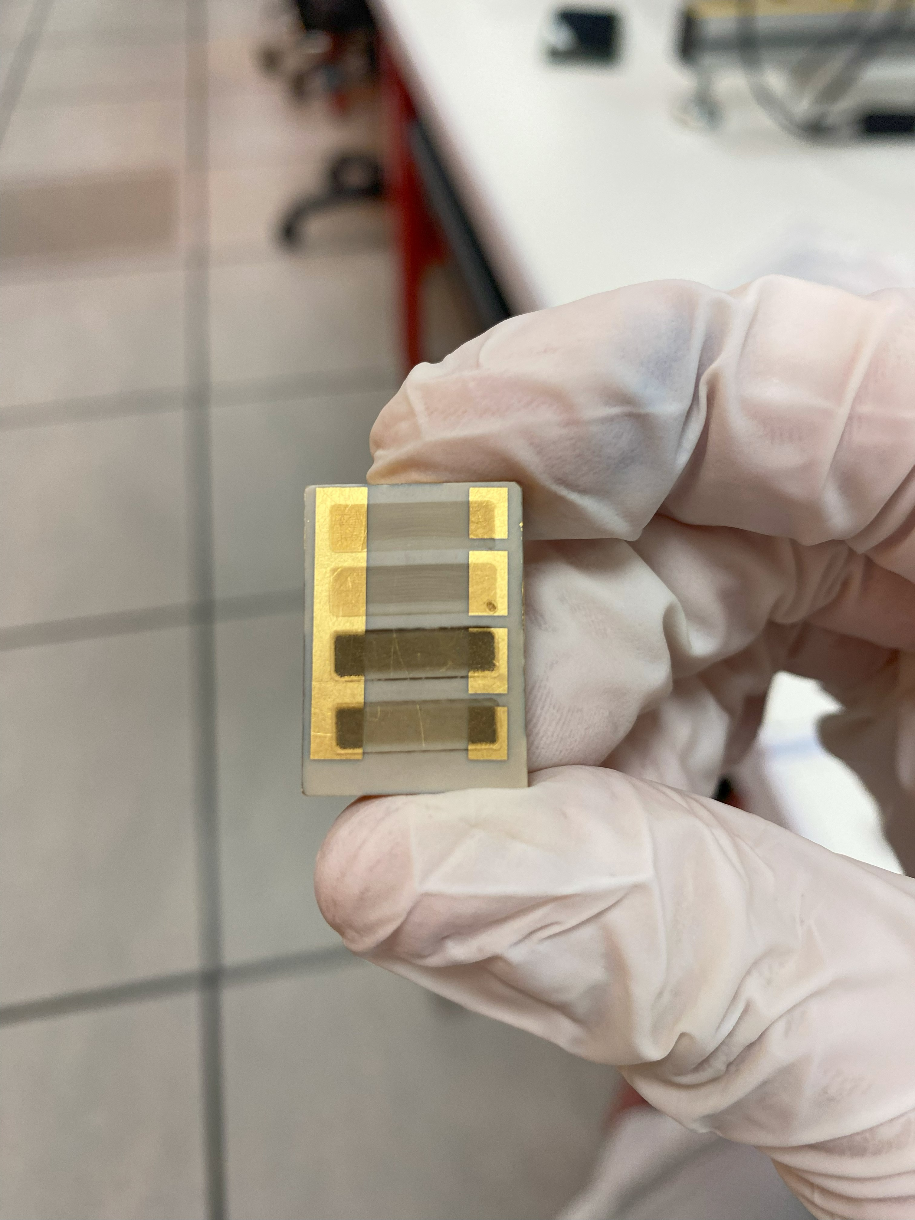
Realisation and installation of electrodes to study the electrical properties of graphene
CROZAT Ilan
4A GPSE
Years 2024 – 2025

Slide 2
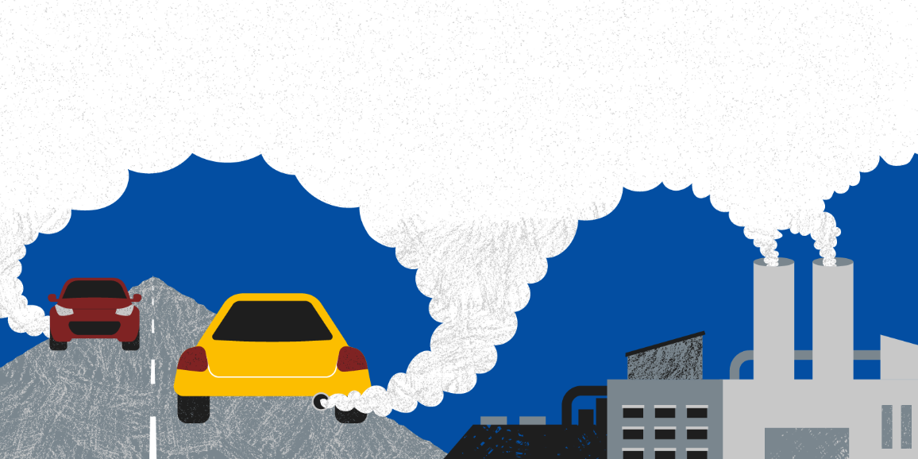

2
Introduction : A world in crisis
Increase of the pollution :
Increase of the world population
Overcunsumption
Development of new and more calorific energy (fossil fuel)
In EU : 200 000 premature death in 2024 due of fine particles, and threatens the biodiversity of forest :
The aim ? Reducing pollution
Polytech Orleans
Ilan CROZAT
2024 - 2025

Slide 3
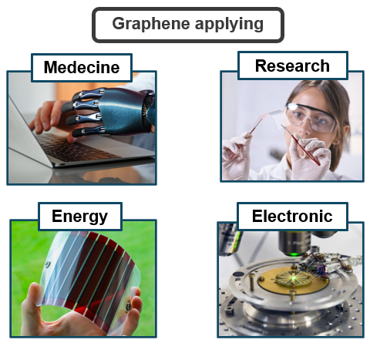
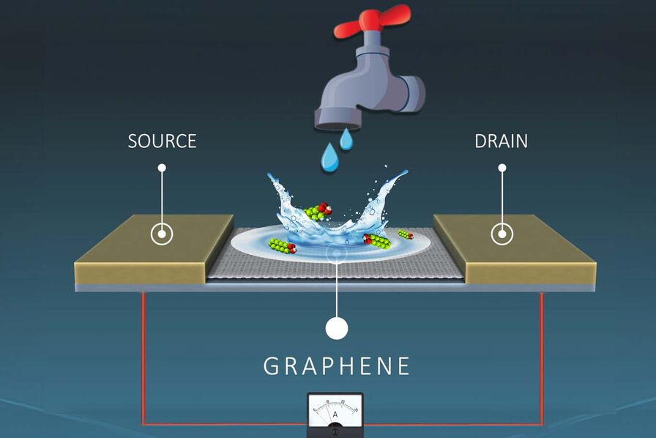
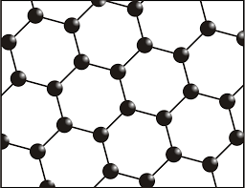
3
Project purpose : a captor made with graphene
Pollution sensor
Growing demand from companies and the public sector
We want : more precise and more reliable
The global project : Develop a pollution sensor
Graphene structure
Polytech Orleans
Ilan CROZAT
2024 - 2025

Slide 4
4
Our project
Our project
Take part of the global project
Studying our graphene properties
Research to made products with different conditions and materials from those of current market sensors
Polytech Orleans
Ilan CROZAT
2024 - 2025

Slide 5
5
Summary
Summary
I . 1 : Octopus diagram
I . 2 : Use-case diagram
I . Fonctional bloks
II . 1 : Peek substrat
II . 2 : Graphene and electrodes deposit
II . 3 : Goals and difficulties
II . Project purpose
Conclusion
III . 1 : Graphite thickness
III . 2 : Mask, design and charaterization
III . 3 : Process flow
III . Conception
Bibliography
IV . 1 : Process-flow application
IV . 2 : Carbon observation with the VHX
IV . 3 : Resist gap
IV . 4 : Observation of the deposed metal
IV . Fabrication and observation
V . Charaterization
V . 1 : Final charaterization
Polytech Orleans
Ilan CROZAT
2024 - 2025

Slide 6
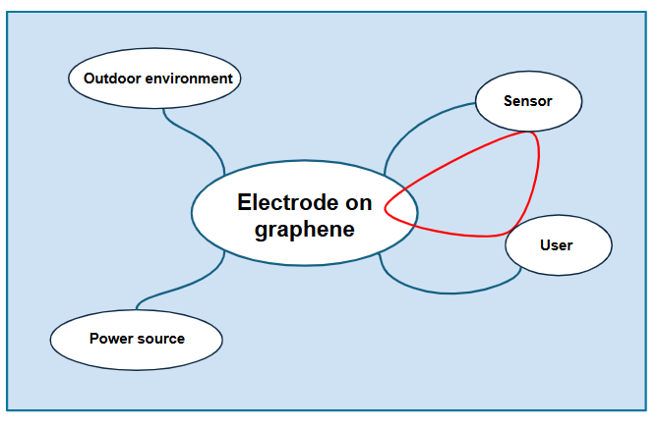
6
I . 1 : Octopus diagram
Polytech Orleans
Ilan CROZAT
2024 - 2025

Slide 7
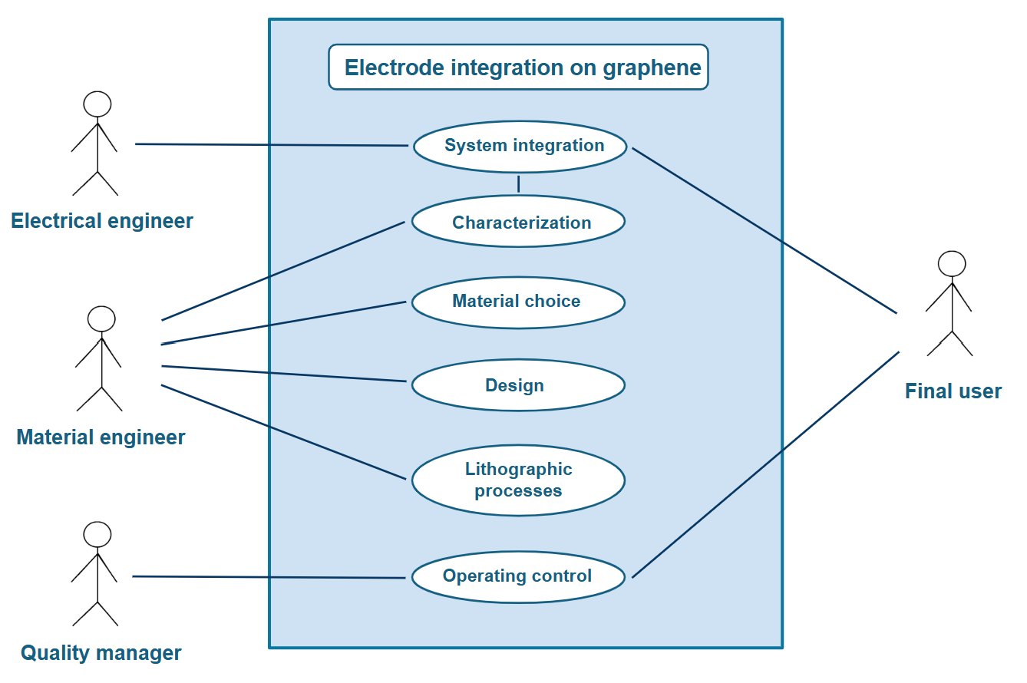
7
I . 2 : Use-case diagram
Polytech Orleans
Ilan CROZAT
2024 - 2025

Slide 8
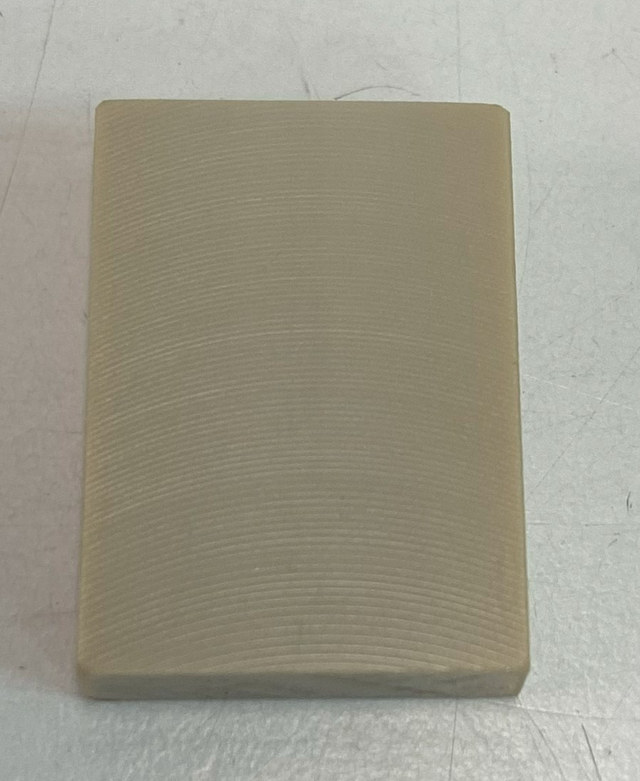
8
II . 1 : Peek substrat
w = 1,7 cm
l = 2,4 cm
Peek substrat
Peek diagram
Polytech Orleans
Ilan CROZAT
2024 - 2025

Slide 9
9
II . 2 : Graphene and electrodes deposit
Peek substrat with graphene, and electrodes
Polytech Orleans
Ilan CROZAT
2024 - 2025

Slide 10
10
II . 3 : Goals and difficulties
Goals
- Designing a process-flow of electrodes on a Peek substrate
- Electrodes fabrication on a carbon-containing substrate
- Graphene charaterization and identification
Dificulties
Conception on Peek : Lack of data, non-adapted material, rough surface…
- Mechanical / Thermal propriety
- Carbon fabrication using laser pulses : modular, precise
Designing the electrodes without any dimension for carbon surfaces
Polytech Orleans
Ilan CROZAT
2024 - 2025

Slide 11
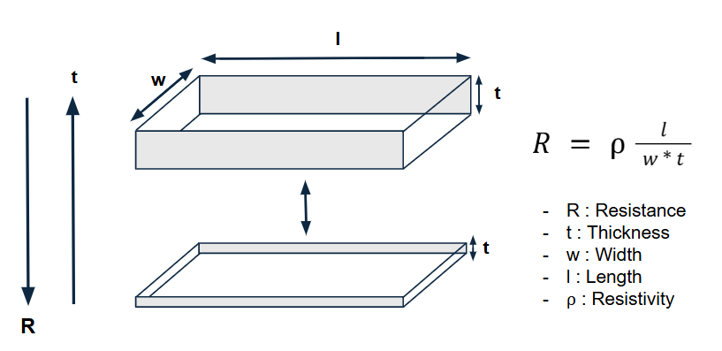
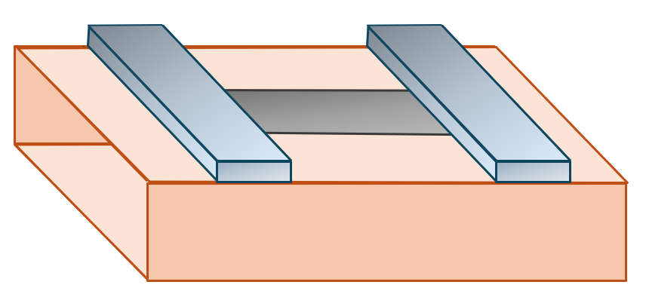
11
III . 1 : Graphite thickness
Thickness :
Resistivity charaterization of the graphene
Carbon thickness can be determined
Polytech Orleans
Ilan CROZAT
2024 - 2025

Slide 12
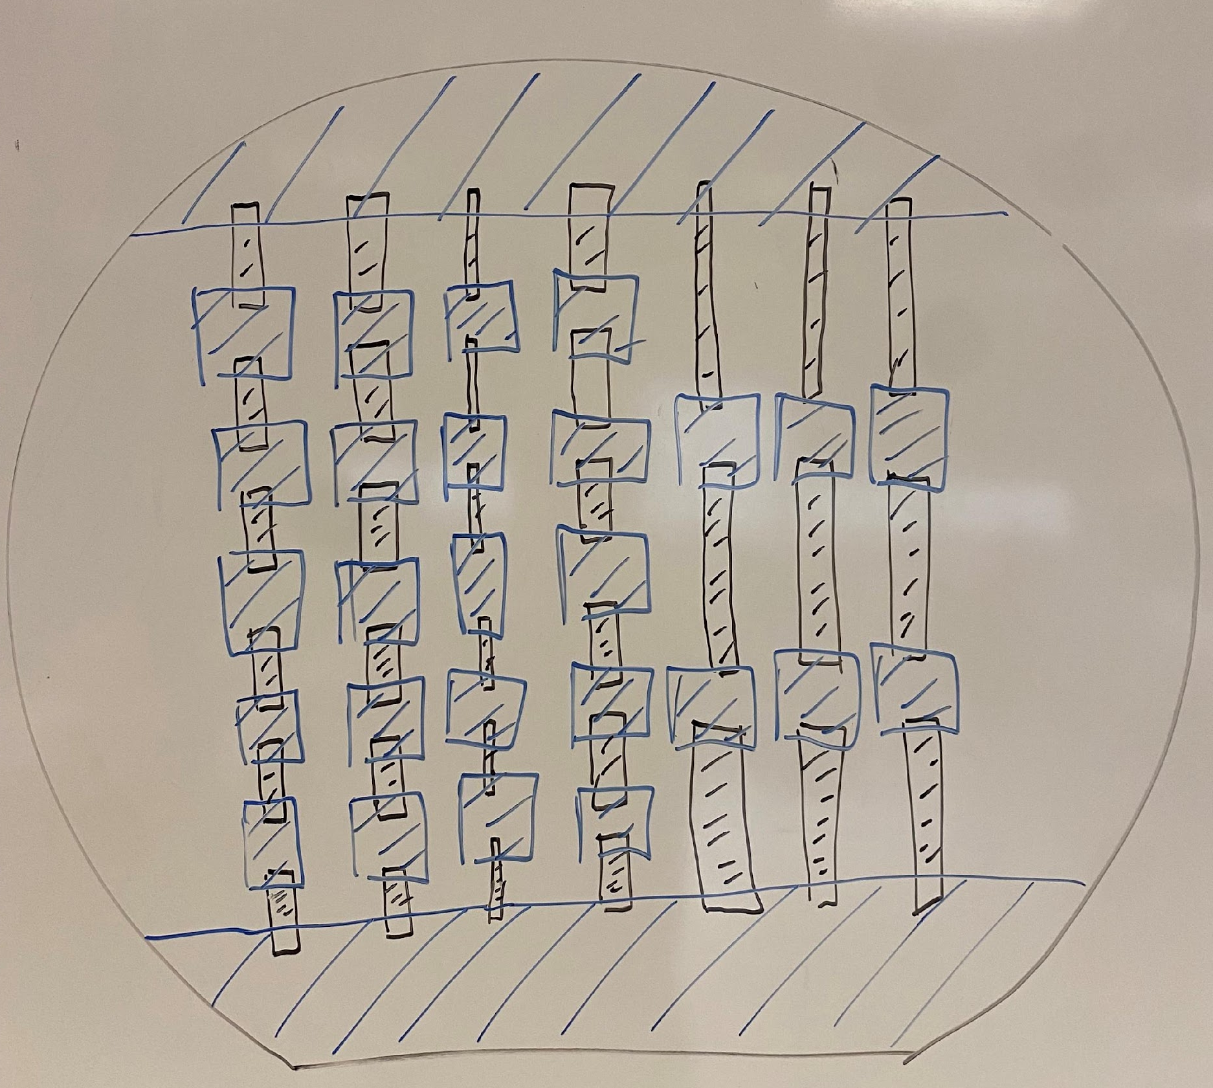
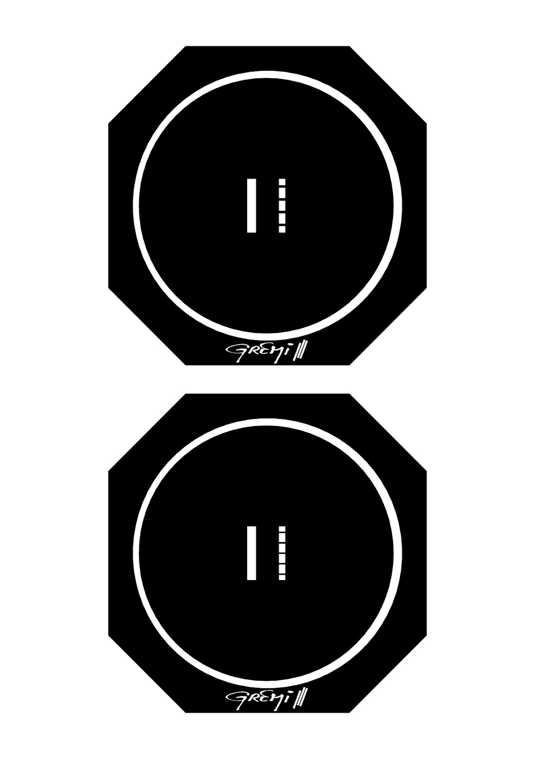
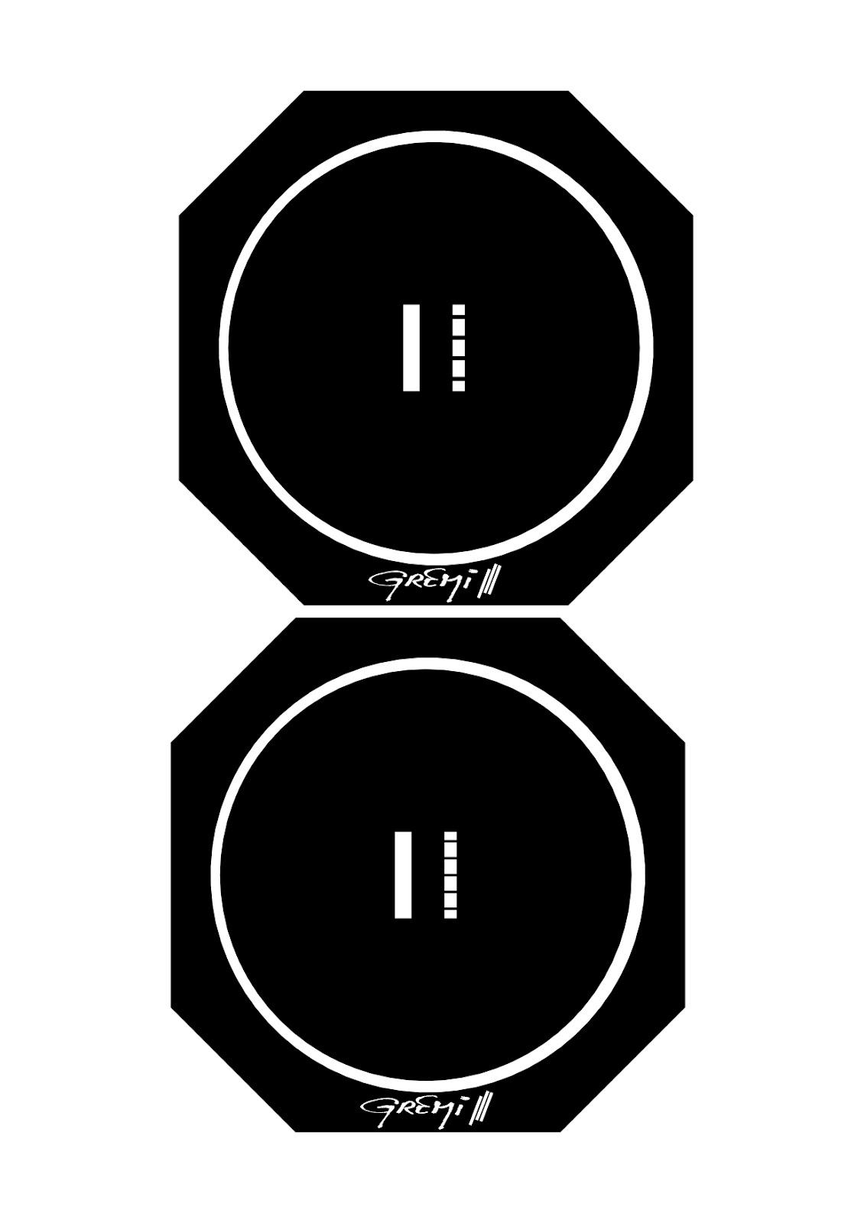
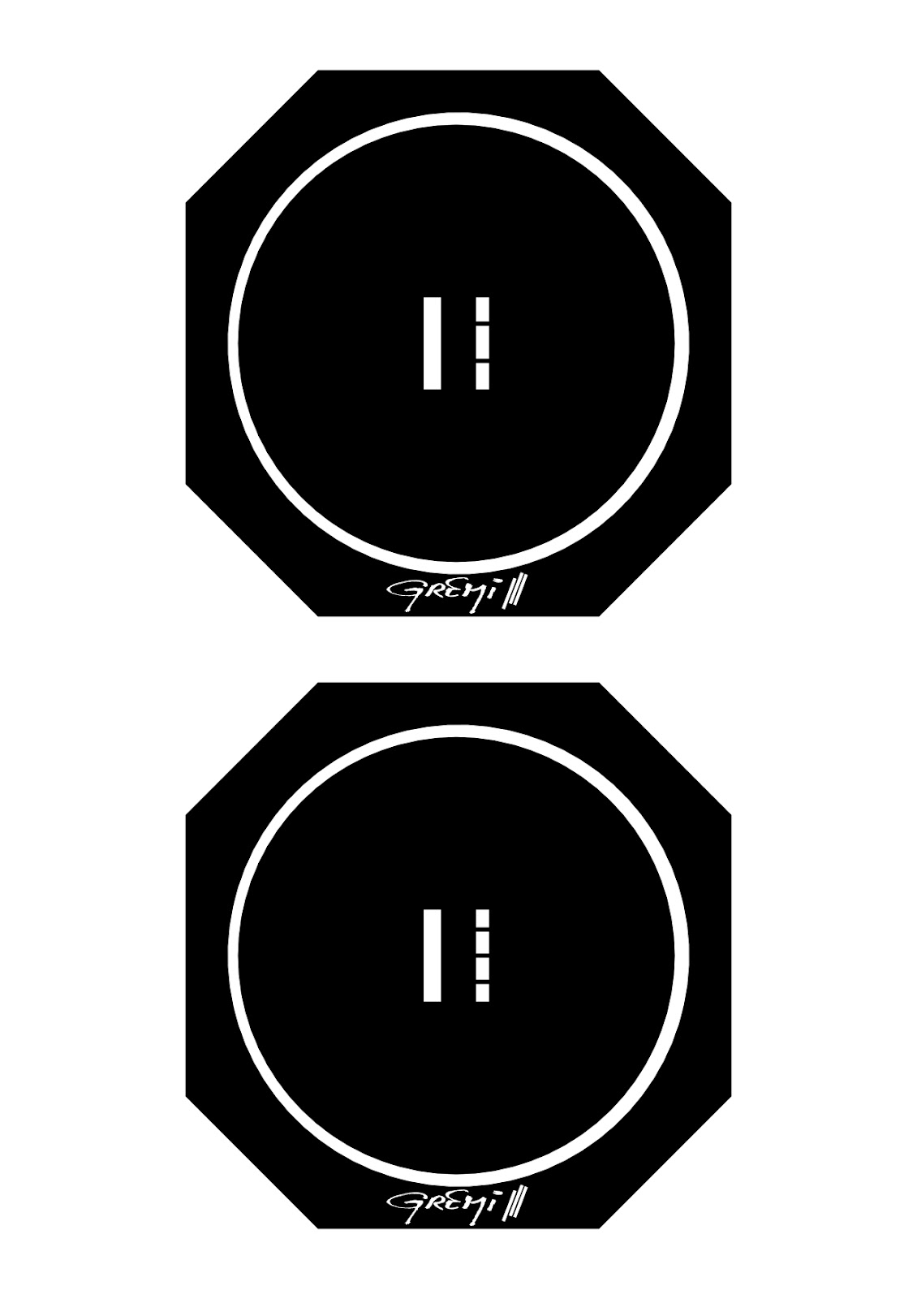
12
III . 2 : Mask, design and charaterization
Mask :
- Use to give the design of the electrodes
- A part lets the UV rays through, the other is opaque
Pattern :
Centered to assure balance during UV insolation
One huge electrode in a side, several in the other side
6 version : one has been used
Inital idea of the mask design
Final version of 6 diffrent mask
Polytech Orleans
Ilan CROZAT
2024 - 2025

Slide 13
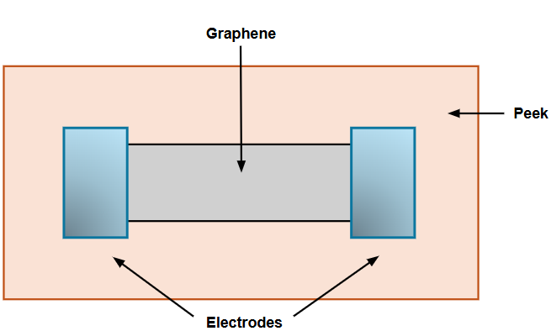
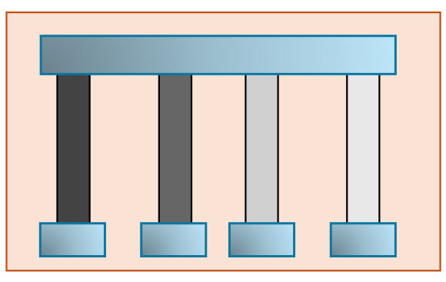
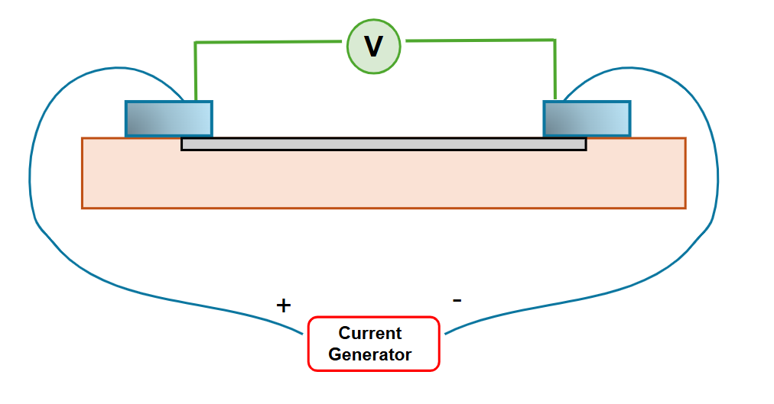
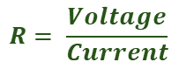
13
III . 2 : Mask, design and charaterization
Design :
- Designing several « ways » to charaterize different carbon surfaces
- One huge electrode to make the resistivity measurement report
Lowest carbon density
$$R= \frac{Voltage}{Current}$$
Highest carbon density
Diagram of the substrat with electrodes
Polytech Orleans
Ilan CROZAT
2024 - 2025

Slide 14
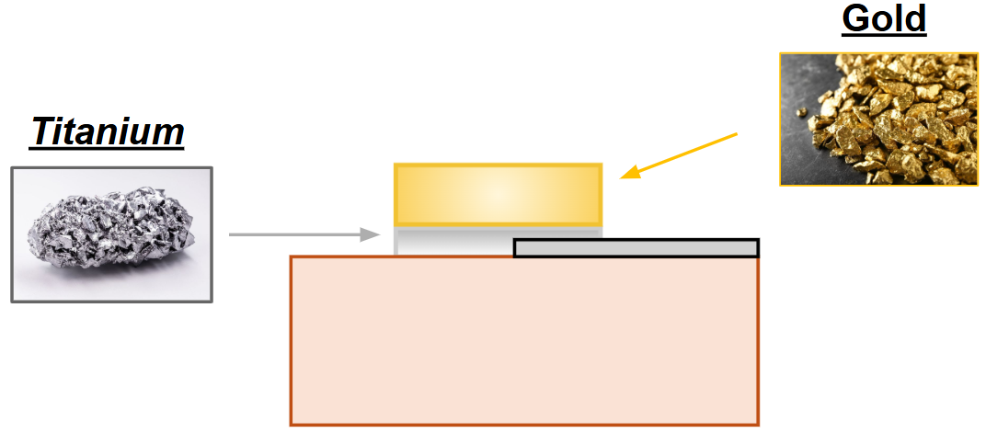
14
III . 3 : Process flow
1
Peek substrat with graphene
5
LOR20B dug by developer product
2
A layer of LOR20B and S1813 (positive resit) deposition, and spreading on the substrat.
Metal deposit with two layers :
6
3
Mask applying + UV irradiation.
SVC-14
7
Lift-off process : removal of all the remaining resist
MF-319
4
Removal of S1813 weakened by UV rays.
8
Final product
Diagram animation of T-Pop process
- Designing a process-flow of electrodes on a Peek substrate
Polytech Orleans
Ilan CROZAT
2024 - 2025

Slide 15
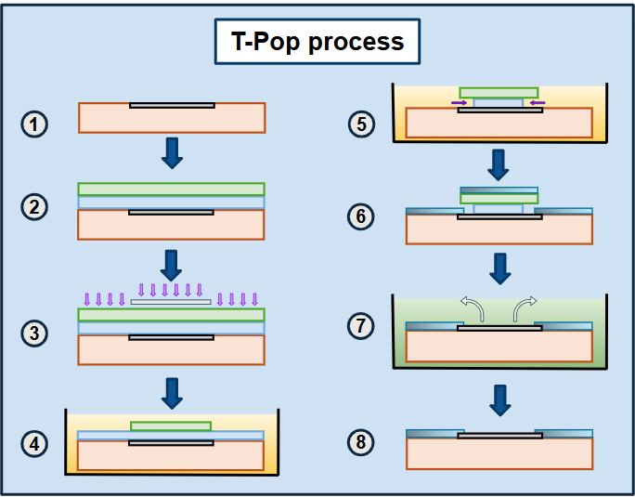
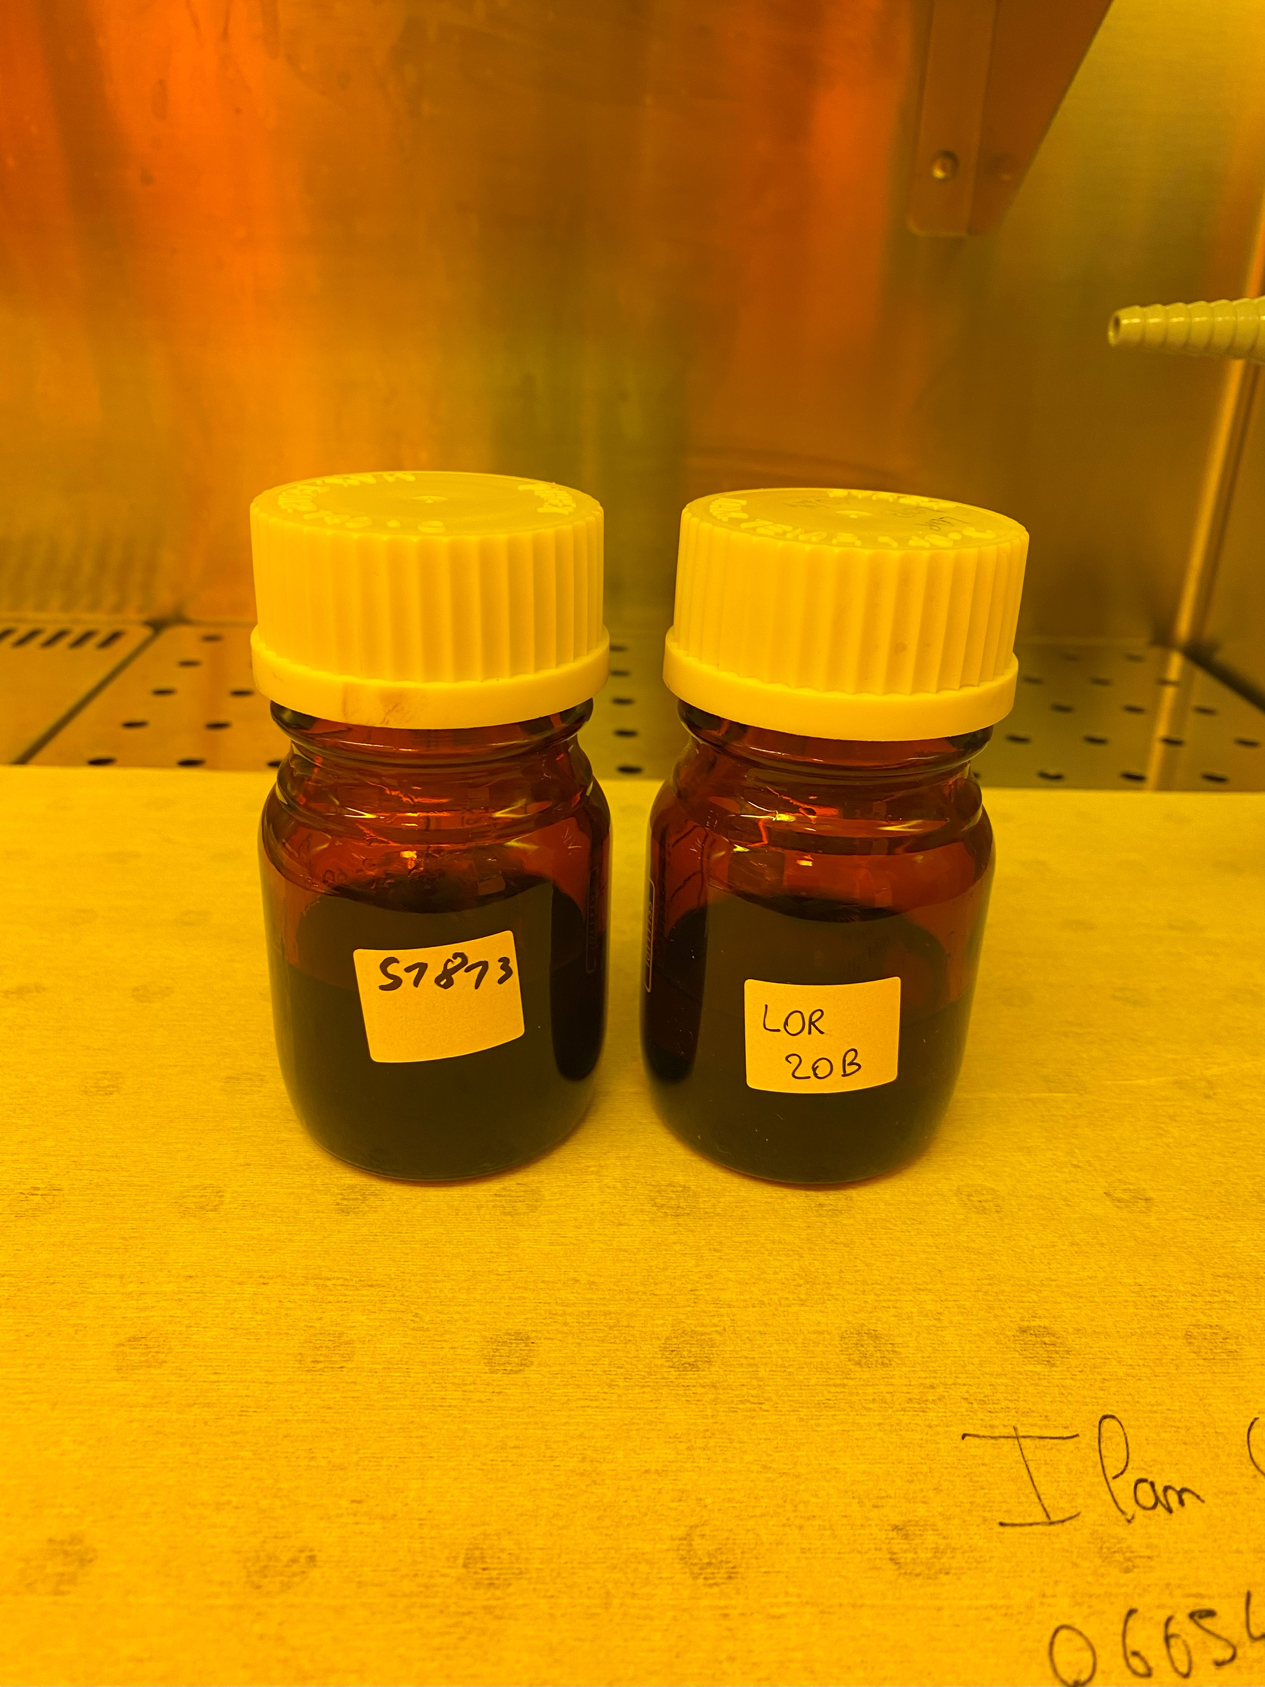
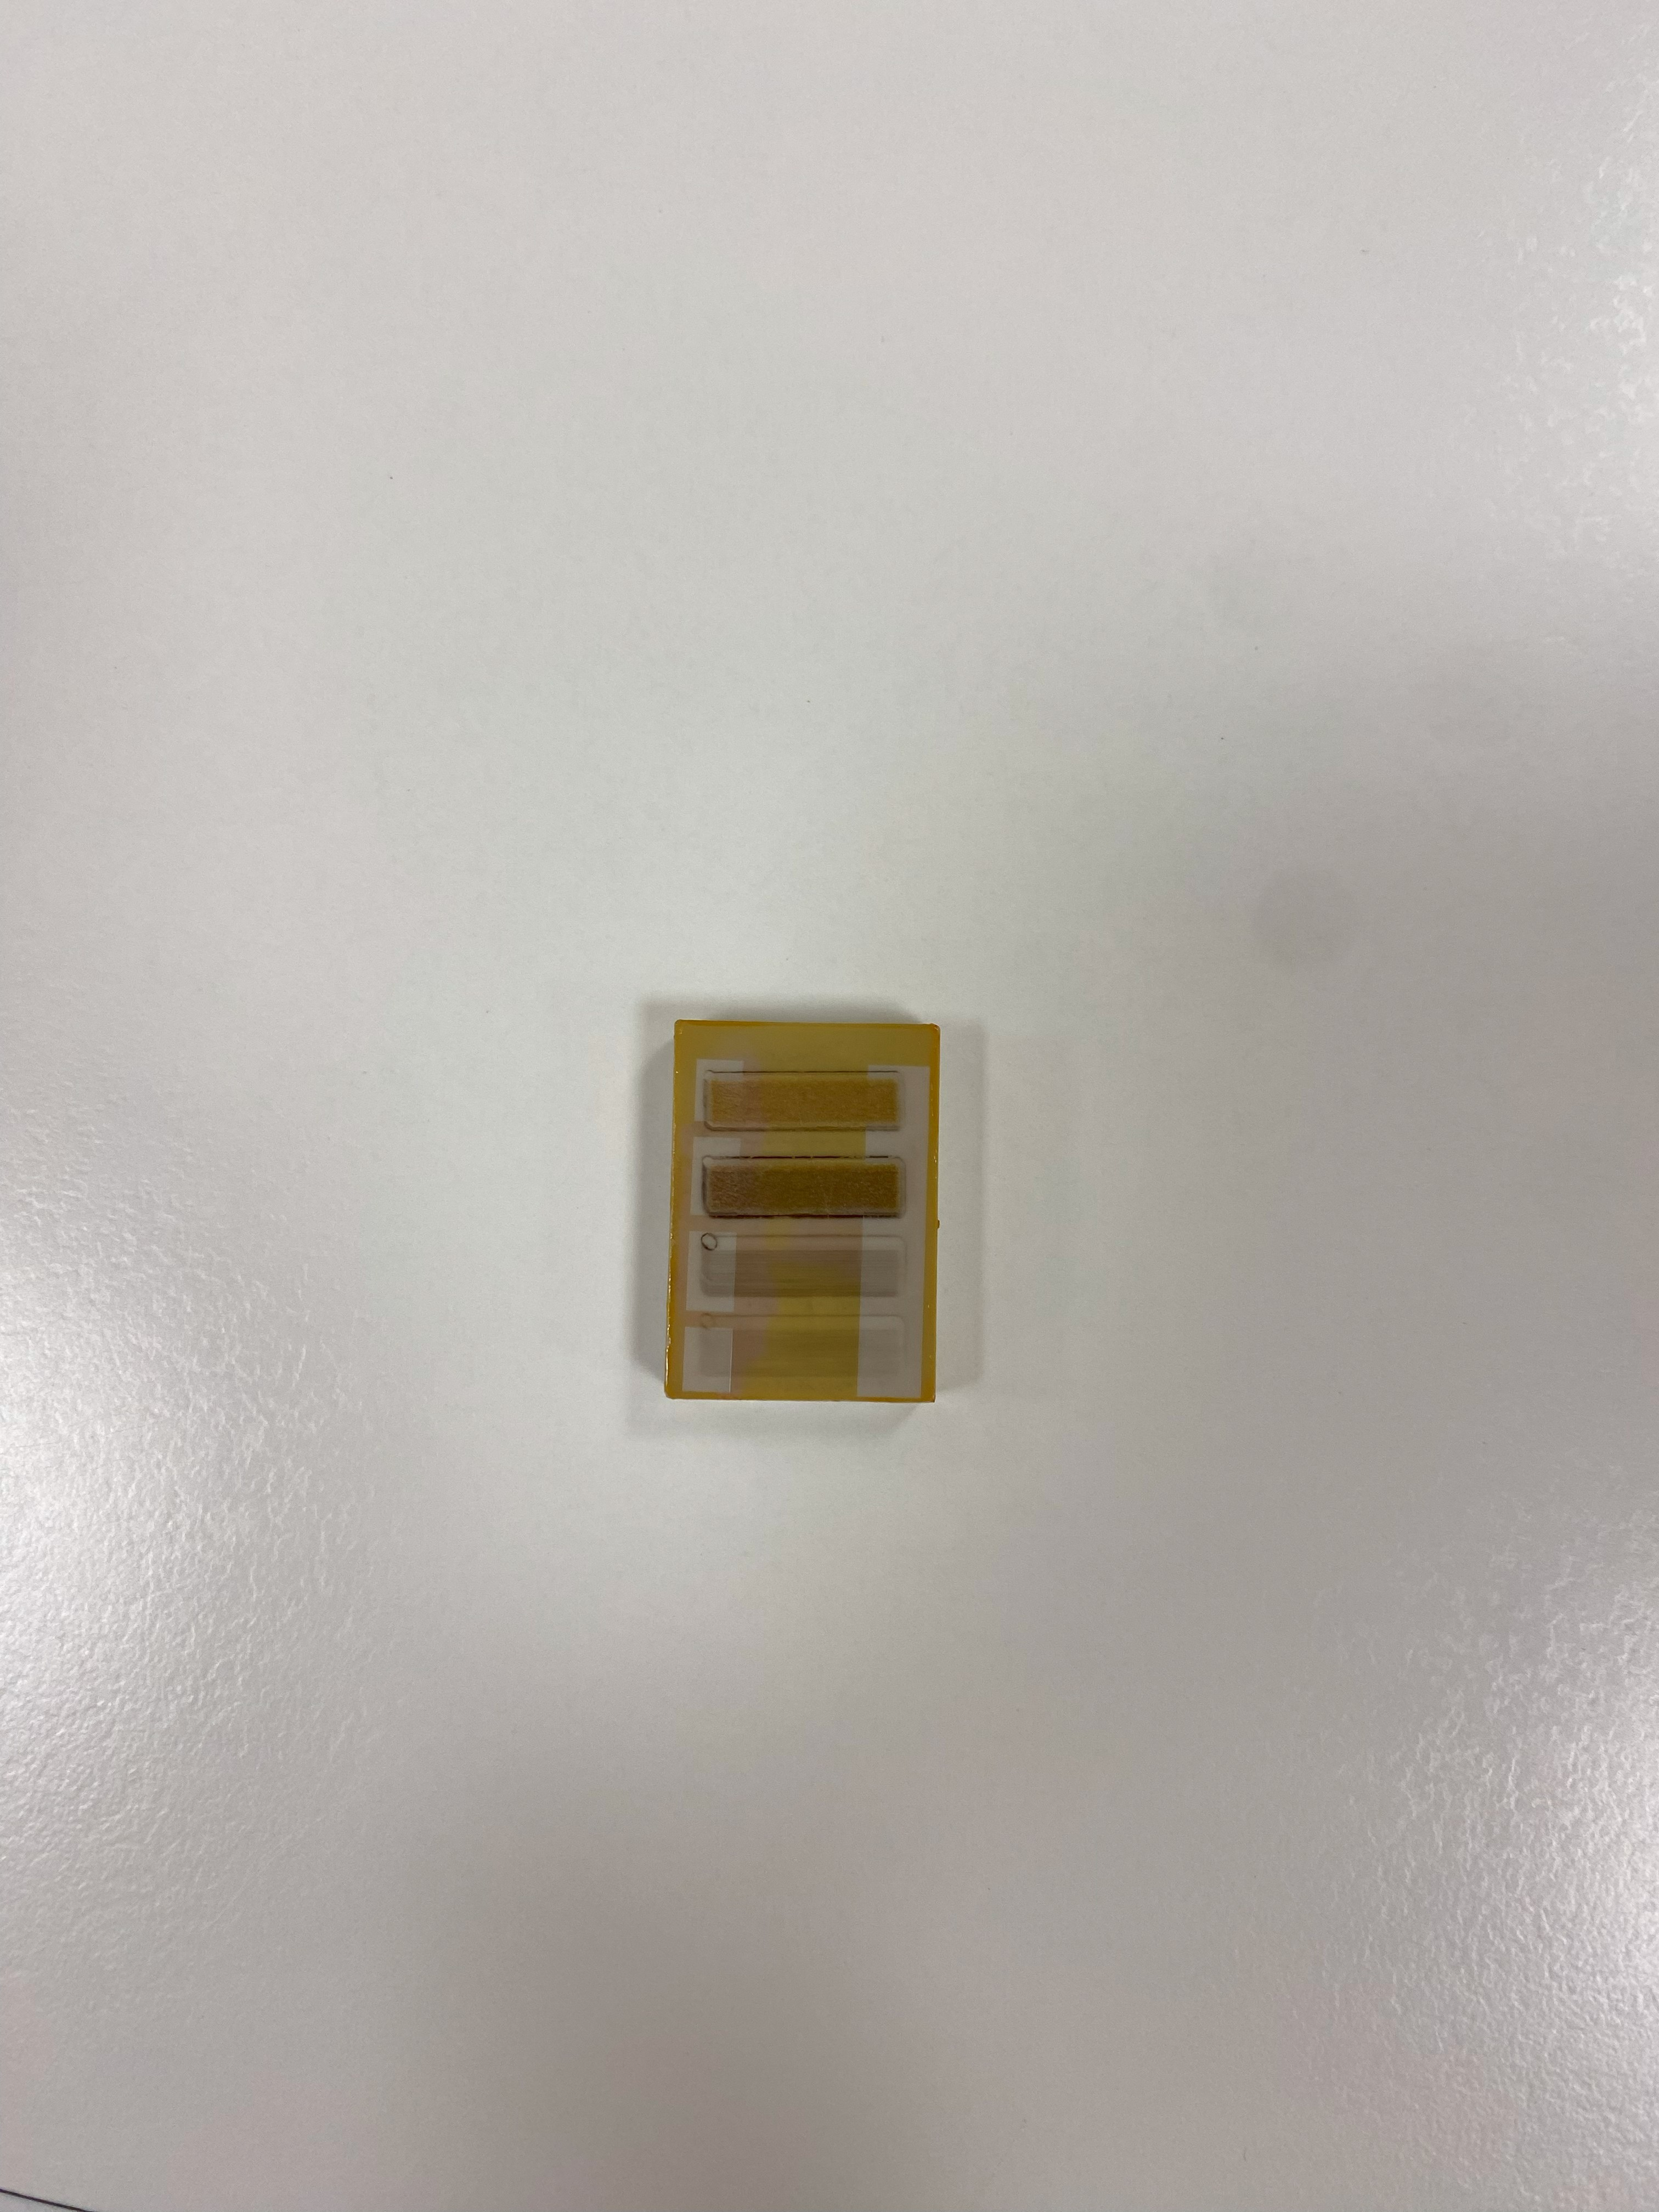
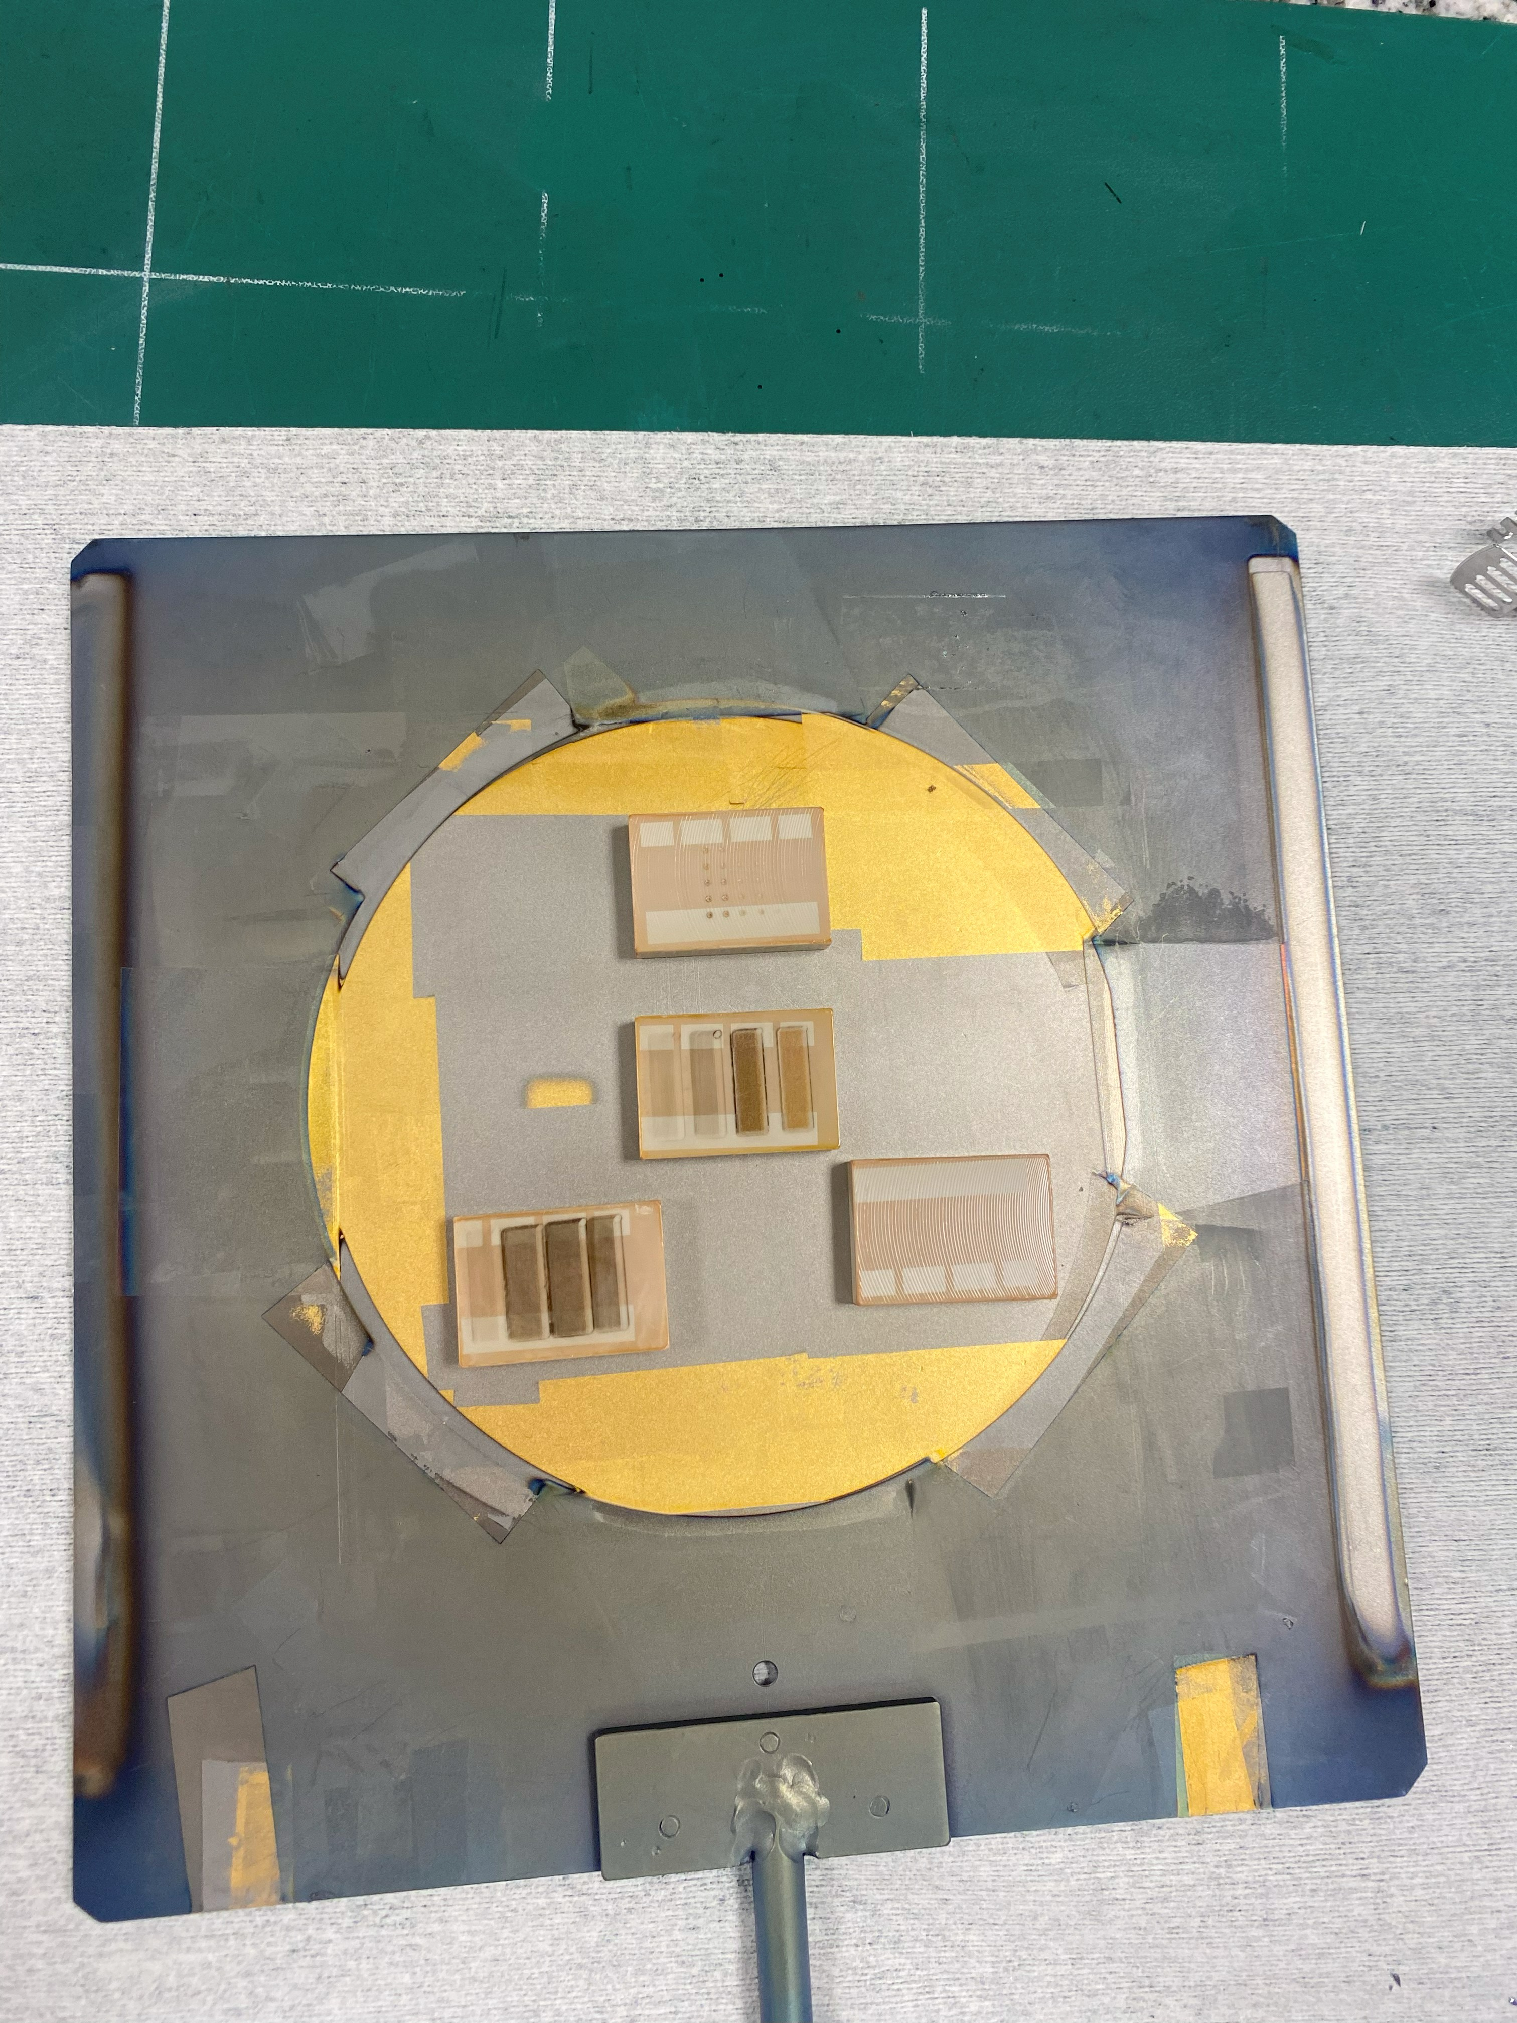
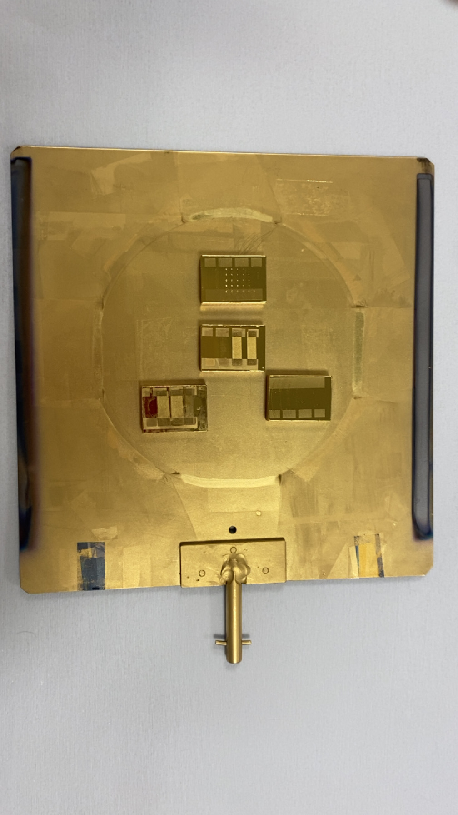
15
IV . 1 : Process-flow application
LOR20B and S1813
After the photolithography
Final product
Before metal deposit
After metal deposit
T-Pop process diagram
- Electrodes fabrication on a carbon-containing substrate
Polytech Orleans
Ilan CROZAT
2024 - 2025

Slide 16
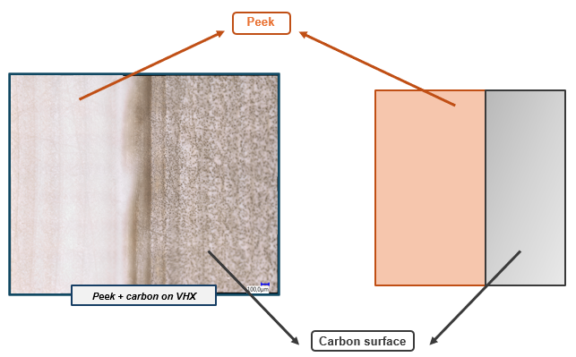
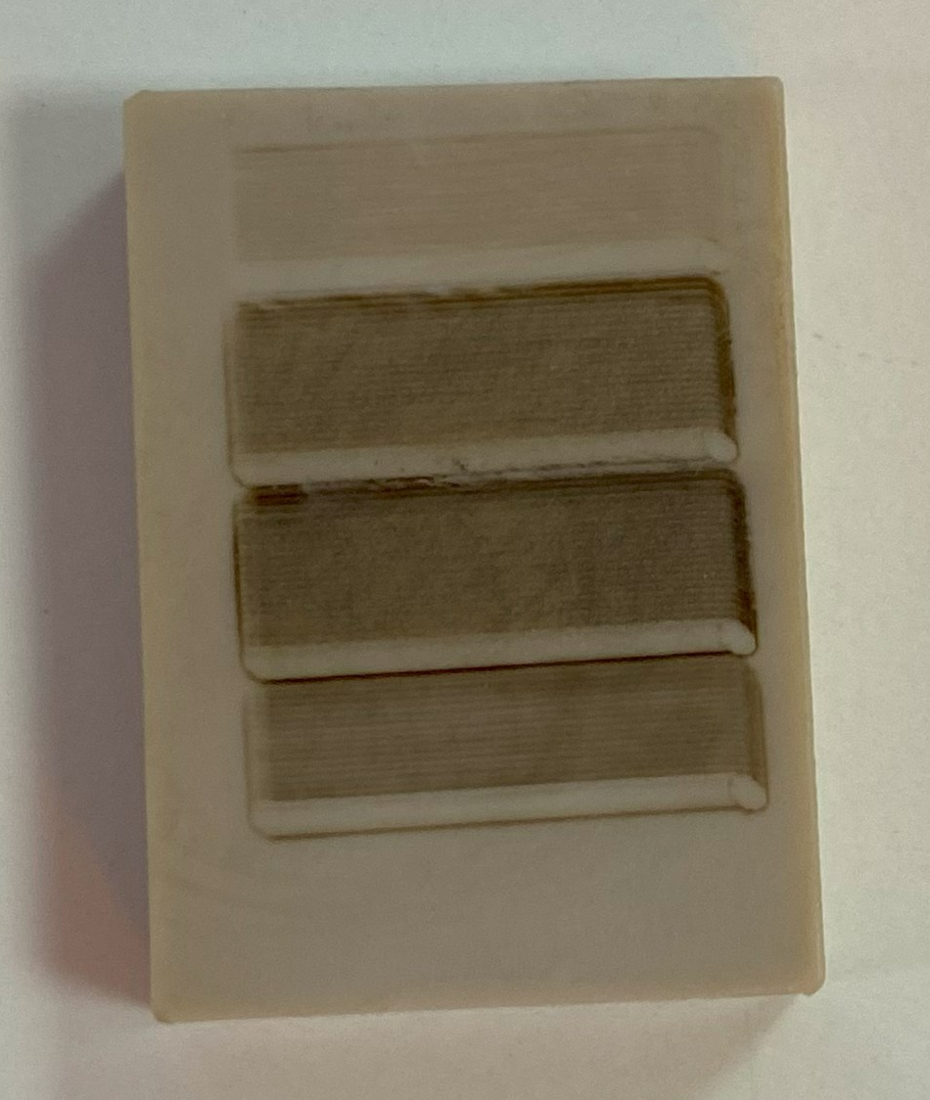
16
IV . 2 : Carbon observation with the VHX
Peek substrat with carbon surface
Polytech Orleans
Ilan CROZAT
2024 - 2025

Slide 17
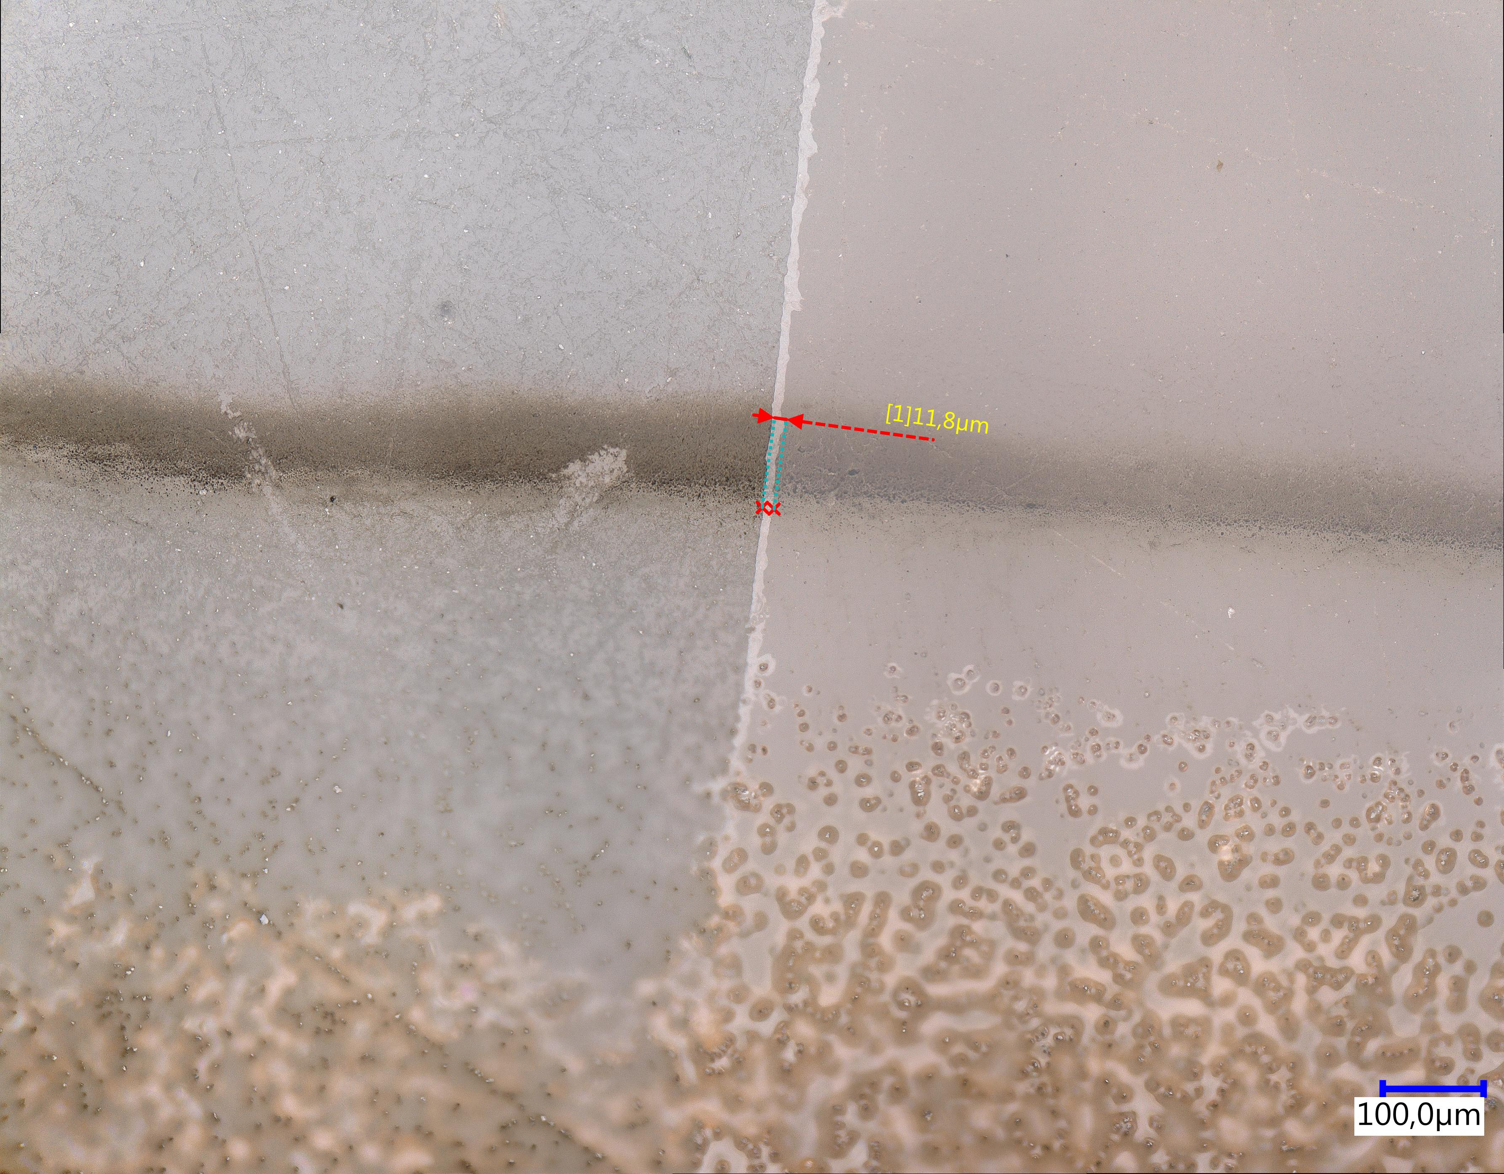
17
IV . 3 : Resist gap
Resist gap on VHX
Resist gap :
We can see it on digital microscope
Means that our T-Pop process worked
Polytech Orleans
Ilan CROZAT
2024 - 2025

Slide 18
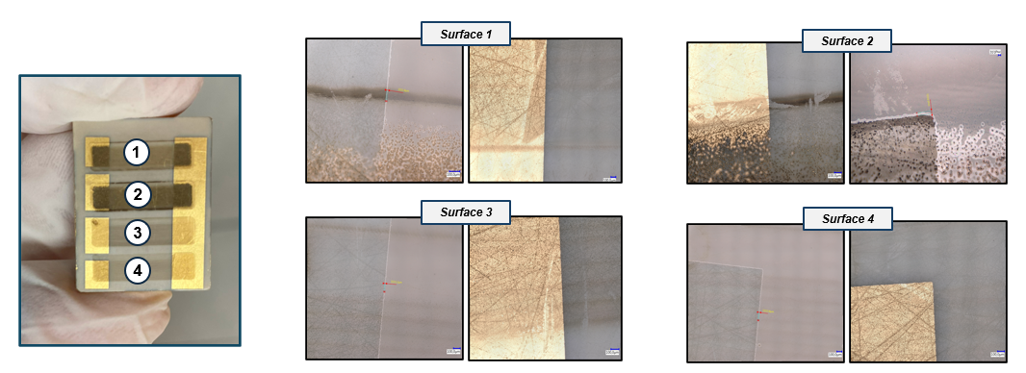
18
IV . 4 : Observation of the deposed metal
After metal deposit :
The metal as been deposited well
Impossible to measure thickness : < um ?
Polytech Orleans
Ilan CROZAT
2024 - 2025

Slide 19
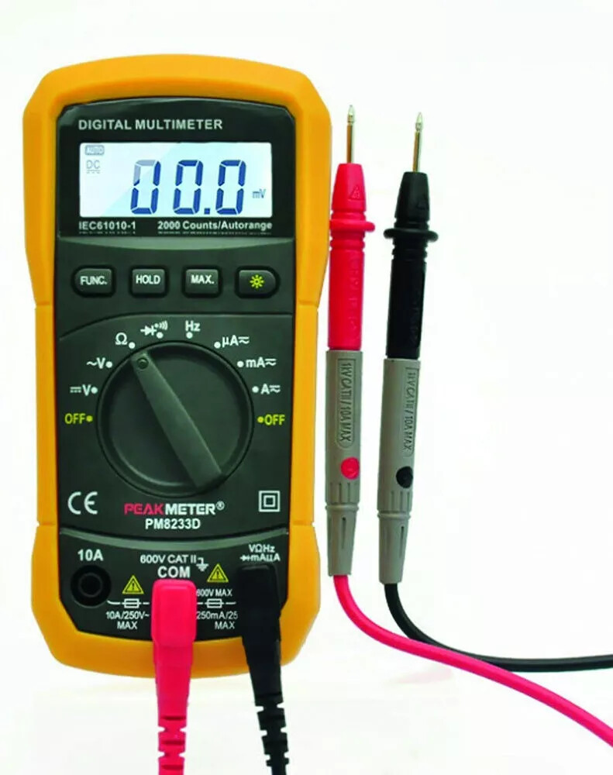
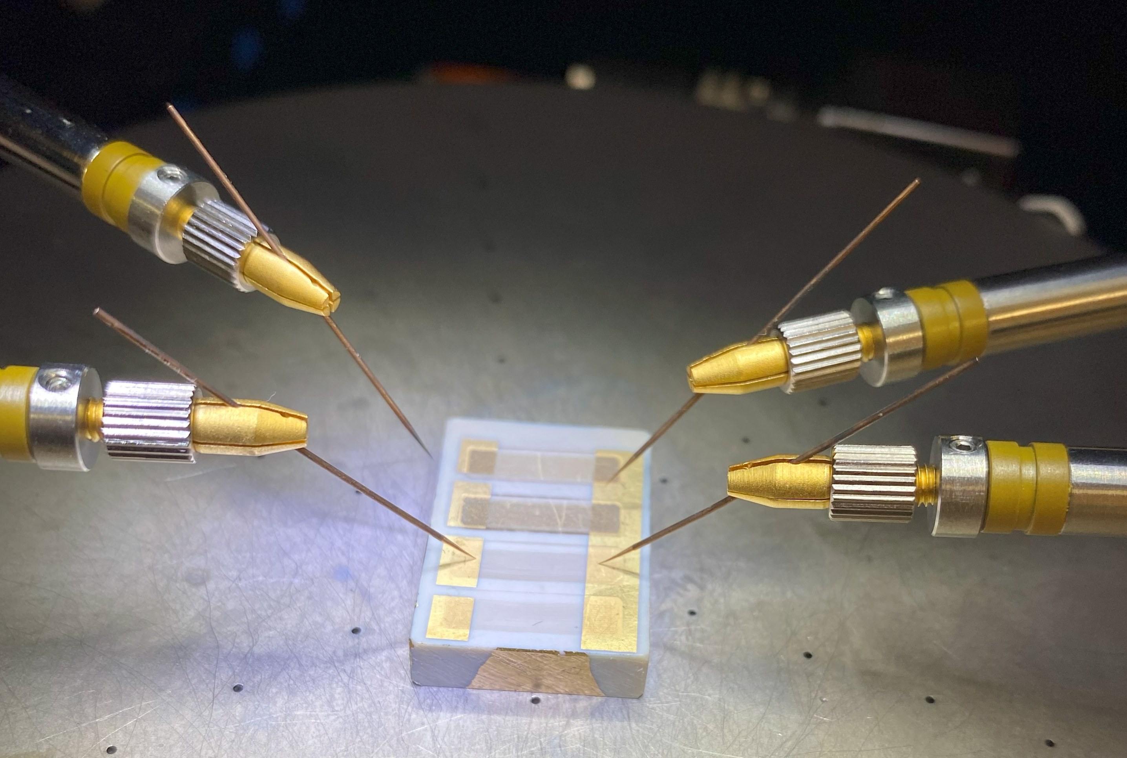
19
V . 1 : Final charaterization
Two needles charaterization
Multimeter
Characterization :
No conductivity found
- Non-homogenous carbon ?
- Carbon removed during the fabrication process ?
- Graphene charaterization and identification
Enhance ideas :
Enhance the process-flow to reduce possible damage
Set up a program with the double needle
Be totally sure about the conductivity of the carbon first
Polytech Orleans
Ilan CROZAT
2024 - 2025

Slide 20
20
Conlusion
Goals
Prospects
Improving the process-flow
Enhance the conception and the design
Using different materials and equipment (metal, rays insolation…)
- Designing a process-flow of electrodes on a Peek substrate
- Electrodes fabrication on a carbon-containing substrate
- Graphene charaterization and identification
Skills
Personnal
Interesting and instructive project
Acquiring and strengthening microfabrication skills
Project in line with my 4th year internship
Level 1 :
Perform micro-fabrication steps in a clean room
Writing a progress report
Level 2 :
Designing a technological microfabrication process flow
Project follow-up
Polytech Orleans
Ilan CROZAT
2024 - 2025

Slide 21
21
Bibliography
Bibliography
Premature deaths due to pollution: - INED
- https://www.ined.fr/fichier/s_rubrique/19627/extraits_urbanisation_monde.fr.pdf
Urbanization of the world: European Environment Agency (EEA) .
https://www.eea.europa.eu/fr/highlights/le-nombre-de-deces-prematures
Combining printed electronics and graphene sensors to accelerate PFD detection
https://www.actu-environnement.com
Lithography techniques: MOOC
lms.fun-mooc.fr
Polytech Orleans
Ilan CROZAT
2024 - 2025

Slide 22
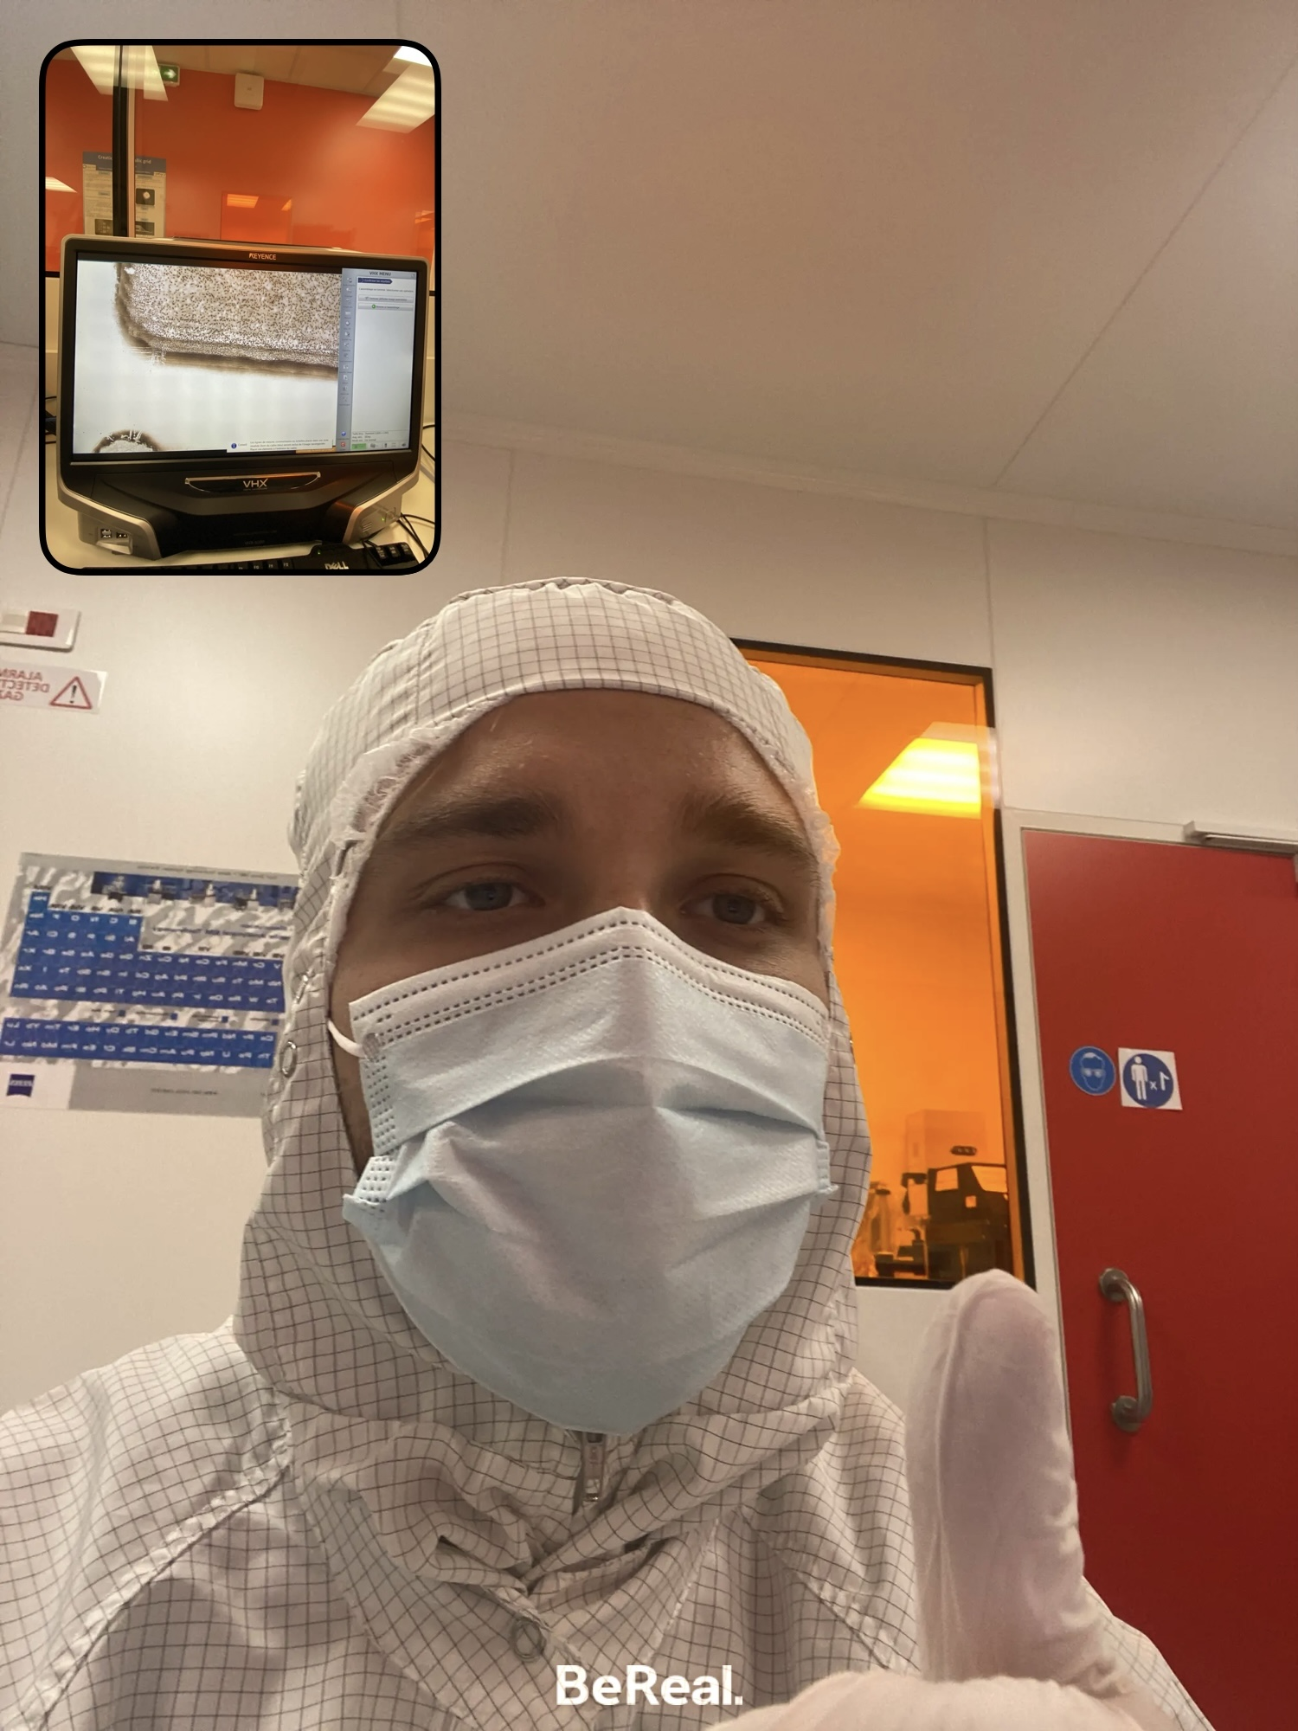
19
The End
Thanks for listening
Polytech Orleans
Ilan CROZAT
2024 - 2025

Slide 23
Annexe
Pollution sensor with graphene
Market analysis
Financial strategy
- Target audience : Biomedical, electronic…
High demand on new material, technology
- Funding source : State, R&D investor…
Return on investment (long term)
Business model
Executive process
Development plan
Development of electrode implementation process
Characterization of the product
- Marketing to bring income on research
Direct incomes :
Licence on the new technology (investment)
Partnership with the research center
Cost structure :
R&D structure
Equipment, area of research
R&D phase, design creation, theory learning
Characterization phase, testing
Industrialisation
Commercialization

Slide 24
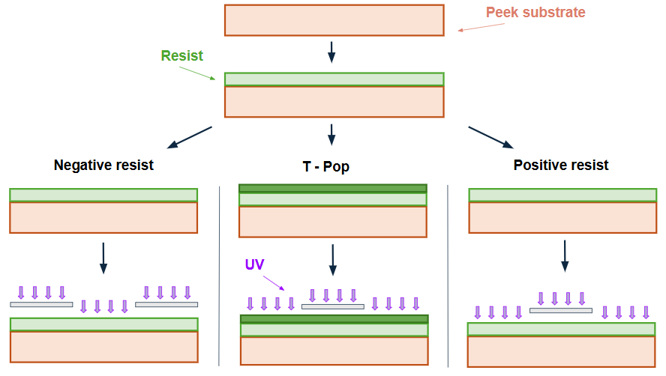
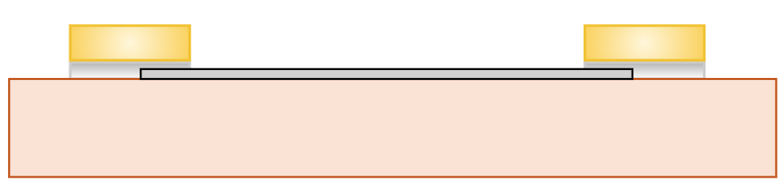
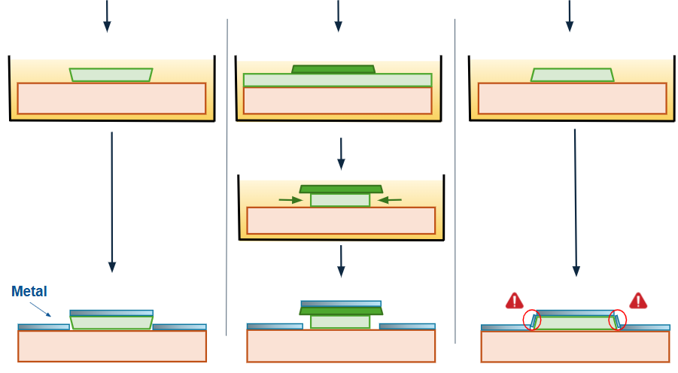
Annexe

Slide 25
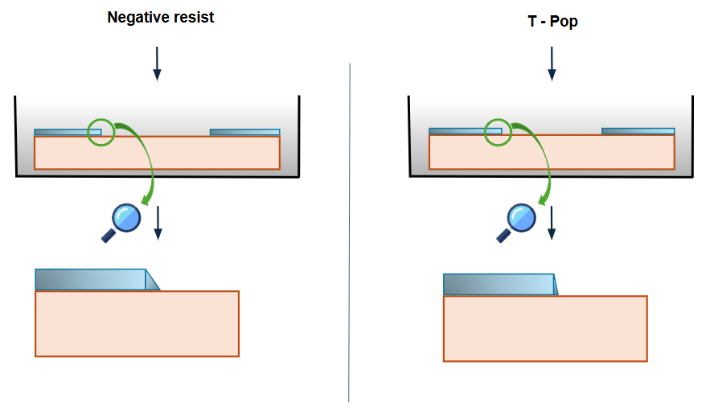
Annexe

